Slide 1
EE 210
LECTURE 7
Responses of First-Order RL and RC Circuits
Cenk Efeler
Reference Book :Electric Cırcuits
James W.Nielson & Susan A.Riedel

Slide 2
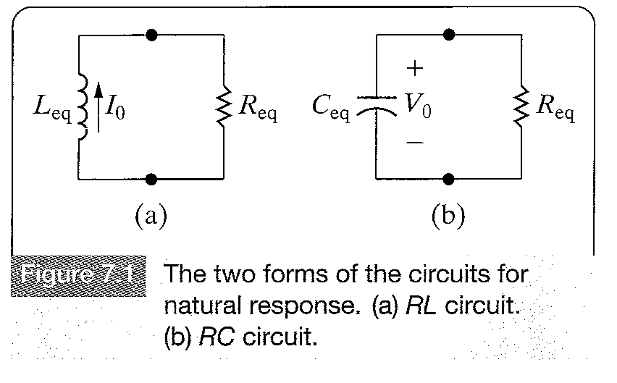
The Natural Response of an RL or RC Circuit
When an inductor or capacitor is suddenly disconnected from a d.c source,natural response occurs.
The cause of natural reponse is the nature of the circuit not an externally applied voltage or current source.

Slide 3
The Natural Response of an RL or RC Circuit
RL and RC circuits are known as first order circuits,because their voltages and currents are described by first order differential equations.
No matter how complex a circuit is,if it can be reduced to a Thevenin equivalent circuit connected to the terminals of an equivalent inductor or capacitor,it is considered a first-order circuit.When multiple inductors or capacitors exists in a circuit,they must be interconnected so that they can be reduced to a single equivalent circuit.

Slide 4
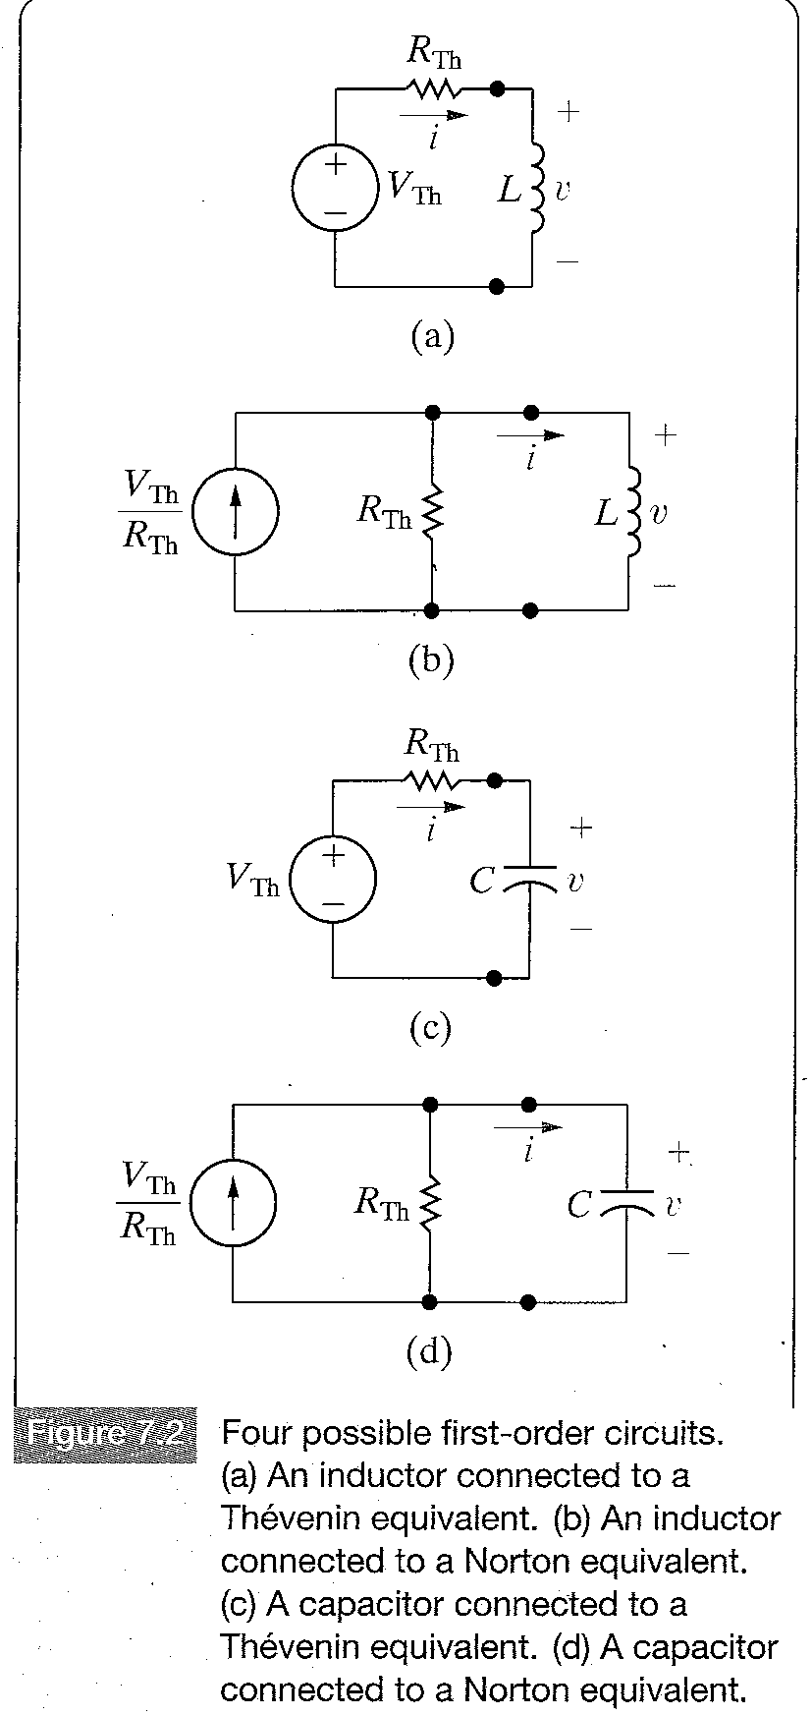
The Natural Response of an RL or RC Circuit
Figure 7.2 shows the four
possibilities for the general
configuration of RL and RC circuits.
Note that, when there are no
independent sources in the circuit,
we have a natural response and
the Thevenin voltage or Norton
current is zero and the circuit
reduces to one of those shown in
Figure 7.1.

Slide 5
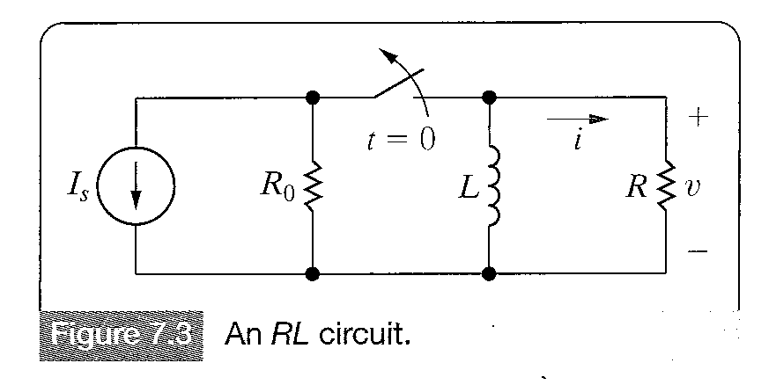
The Natural Response of an RL Circuit
The natural response of an RL circuit can best be described in terms of the circuit shown in Figure 7.3.
We assume that the switch has
been closed for a long time.
Long time means all currents
and voltages have reached a
constant value.In this case only
constant,or d.c currents can exist
in the circuit,therefore =0,thus
=0, prior to the release
of the stored energy.

Slide 6
The Natural Response of an RL Circuit
Since the inductor apears as a short circuit,the voltage across the inductive branch is zero.Thus all the current goes through the inductive branch and there can be no current in either of the resistances R0 and R.
Finding the natural response requires finding the voltage and current at the terminals of the resistor after the switch has opened,that is after the current source has been disconnected and the inductor begins releasing its energy.

Slide 7
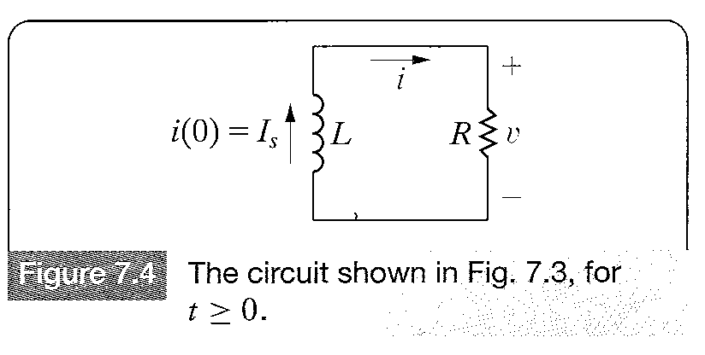
The Natural Response of an RL Circuit
The problem becomes finding v(t) and i(t) for t>=0. For t>=0,the circuit shown in Figure 7.3 reduces to the one shown in Figure 7.4
Using Kirchoff’s voltage law
(7.1)
where passive sign
convention has been used.

Slide 8
The Natural Response of an RL Circuit
Equation (7.1) is a first-order ordinary differential equation,because it contains terms involving the ordinary derivative of the unknown current i,
The highest order derivative in the equation 1 is 1,thus the term first-order.
As the coefficients of the terms in the equation are constant,we can describe the above equation as an ordinary differential equation with constant coefficients.
Also because there are no excitation sources, when computing the natural response of a circuit,the right-hand side of the differential equation is zero,thus the equation is a homogeneous differential equation.

Slide 9
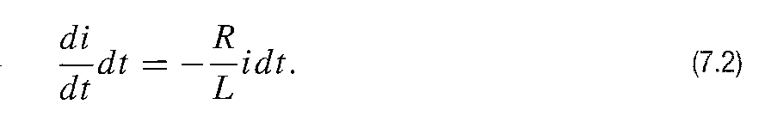
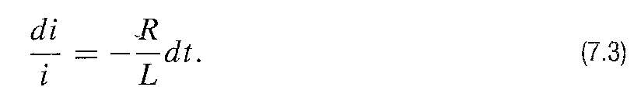
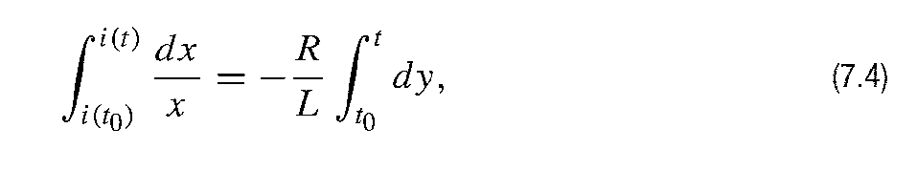
The Natural Response of an RL Circuit
To solve the above equation, we divide both sides by L and transfer the term involving i to the right-hand side and then multiply both sides bu a differential time dt.
The results is
Next we divide both sides by i.
Integrating both sides yield

Slide 10
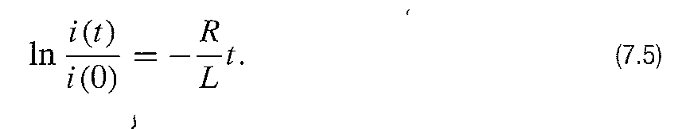
The Natural Response of an RL Circuit
in which i(t0) is the current corresponding to time t0 and i(t) is the current corresponding to time t.Here t0=0.

Slide 11
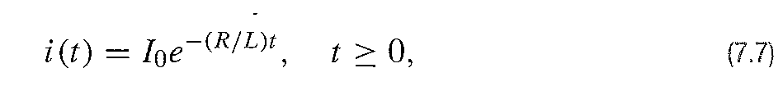
The Natural Response of an RL Circuit
Due to the continuity condition of the inductor current ,where denotes the initial current in the inductor.
The initial current in the inductor is in the same direction as the reference direction i,equation 7.6 becomes.

Slide 12
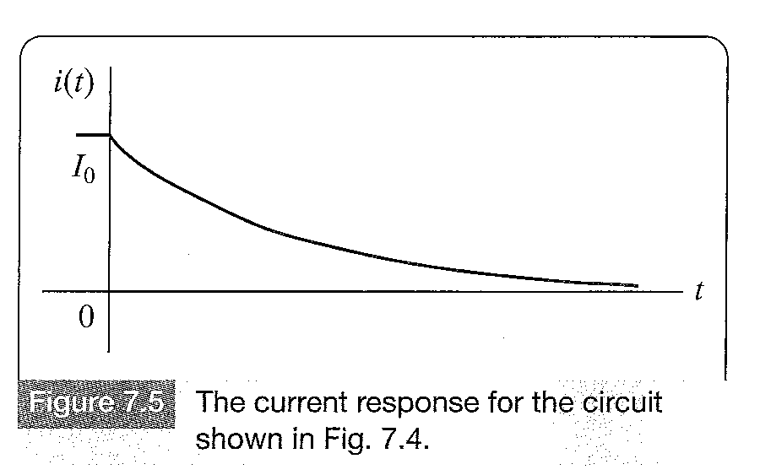
The Natural Response of an RL Circuit
Figure 7.5 shows this response.

Slide 13
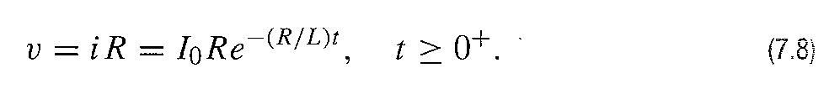
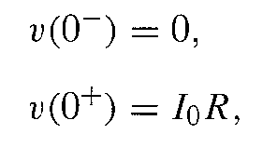
The Natural Response of an RL Circuit
The voltage across the resistor can be derived from a direct application of Ohm’s law.
Note that unlike the expression for the current given in equation 7.7,the voltage is defined only for t>0,not at t=0. This is because a step change occurs in the voltage at zero.Also note that for t<0,the derivative of the current is zero,so the voltage is zero ,because
=0. Thus

Slide 14



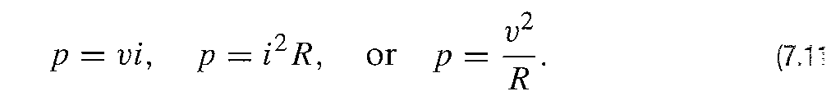
The Natural Response of an RL Circuit
Where is obtained from Equation (7.8) with
.With this step change at an instant in time,the value of the voltage at t=0 is unknown.Thus
is used in defining the region of validity for these solutions.
The power dissipated in the resistor can be derived from any of the following expressions:

Slide 15
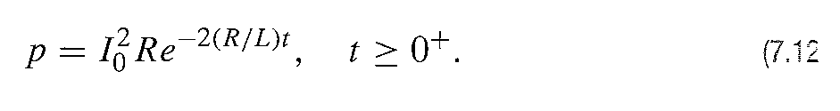
The Natural Response of an RL Circuit
Using any of the forms above,the resulting expression can be reduced to
The energy delivered to the resistor during any interval of time after the switch has been opened is

Slide 16
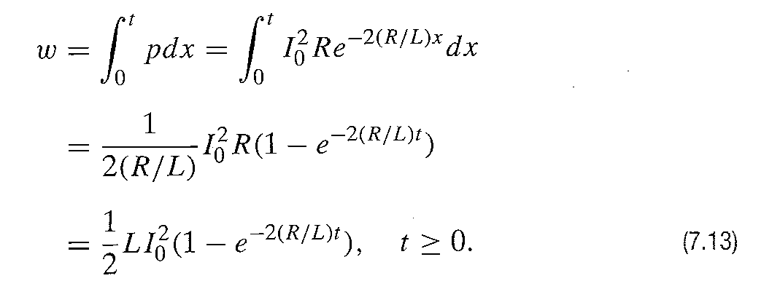
The Natural Response of an RL Circuit
As t becomes infinite,the energy dissipated in the resistor approaches the initial energy stored in the inductor.

Slide 17
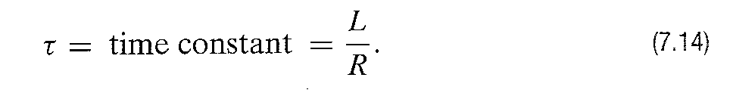
The Significance of Time Constant
The coefficient of t in the above equation namely R/L determines the rate at which the current or voltage approaches zero.
The reciprocal of this ratio is the time constant of the circuit,denoted

Slide 18
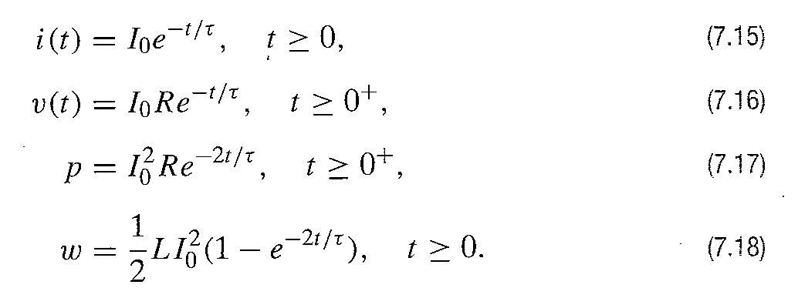
The Significance of Time Constant
Using the time-constant concept the equations for current,voltage,power and energy can be written as

Slide 19
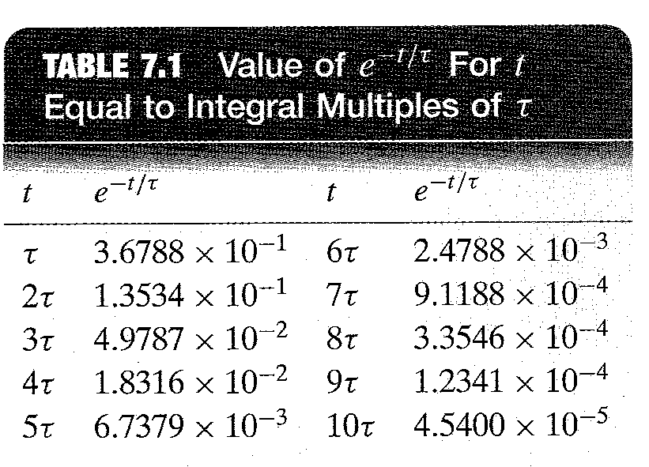
The Significance of Time Constant
We can think of the time elapsed after the switching in terms of the time constant .
Table 7.1 gives the values of for integral multiples of .

Slide 20
The Significance of Time Constant
We notice that when the elapsed time exceeds five time constants,the current is less than 1% of its initial value.Thus,after five time constants,the currents and voltages have for all practical purposes reached their final values.For single time-constant circuits(first-order circuits) with 1% accuracy,the phrase a long time implies that five or more time constants have elapsed.Thus in an RL circuit current exist only for a limited period of time,and the response is temporary.For this reason the response is called transient responce.The response that exists after a long time has expired after switching is called the steady-state response.

Slide 21
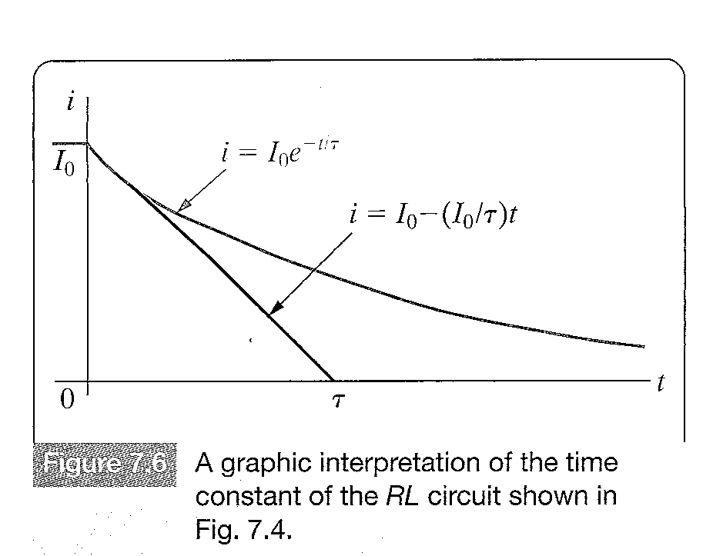
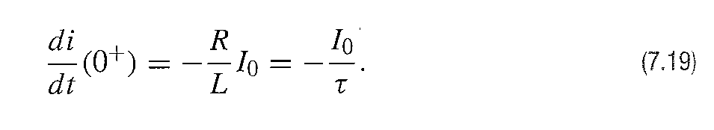
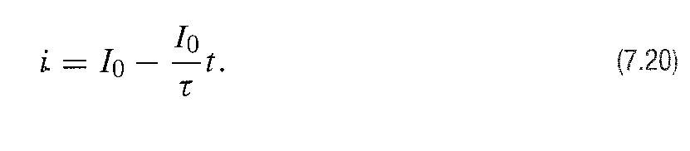
The Significance of Time Constant
Any first order circuit is characterized in part by the value of its time constant.
The time constant can be determined from a plot of its response.

Slide 22
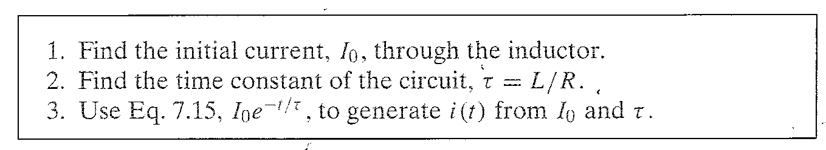
The Natural Response of an RL Circuit
Calculating the natural response of an RL circuit can be summarized as follows:

Slide 23
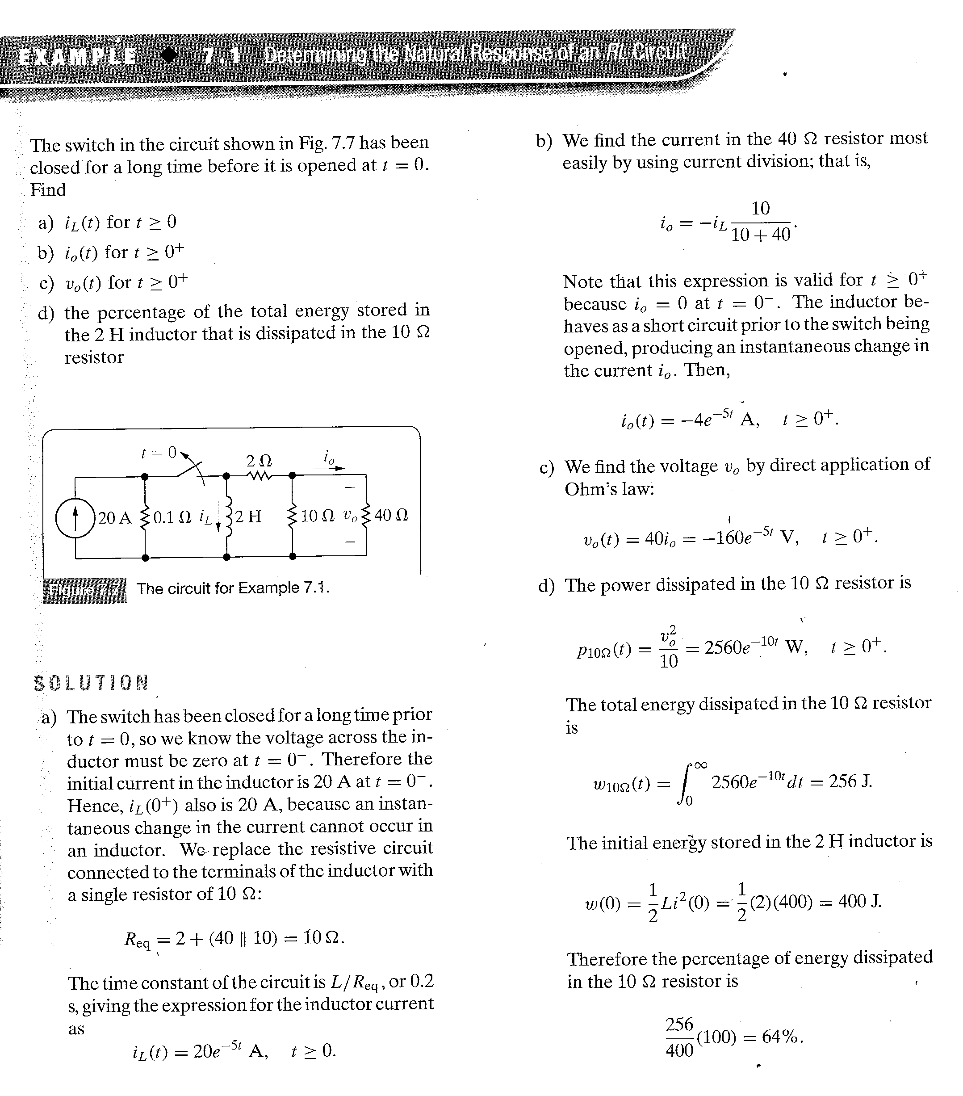

Slide 24
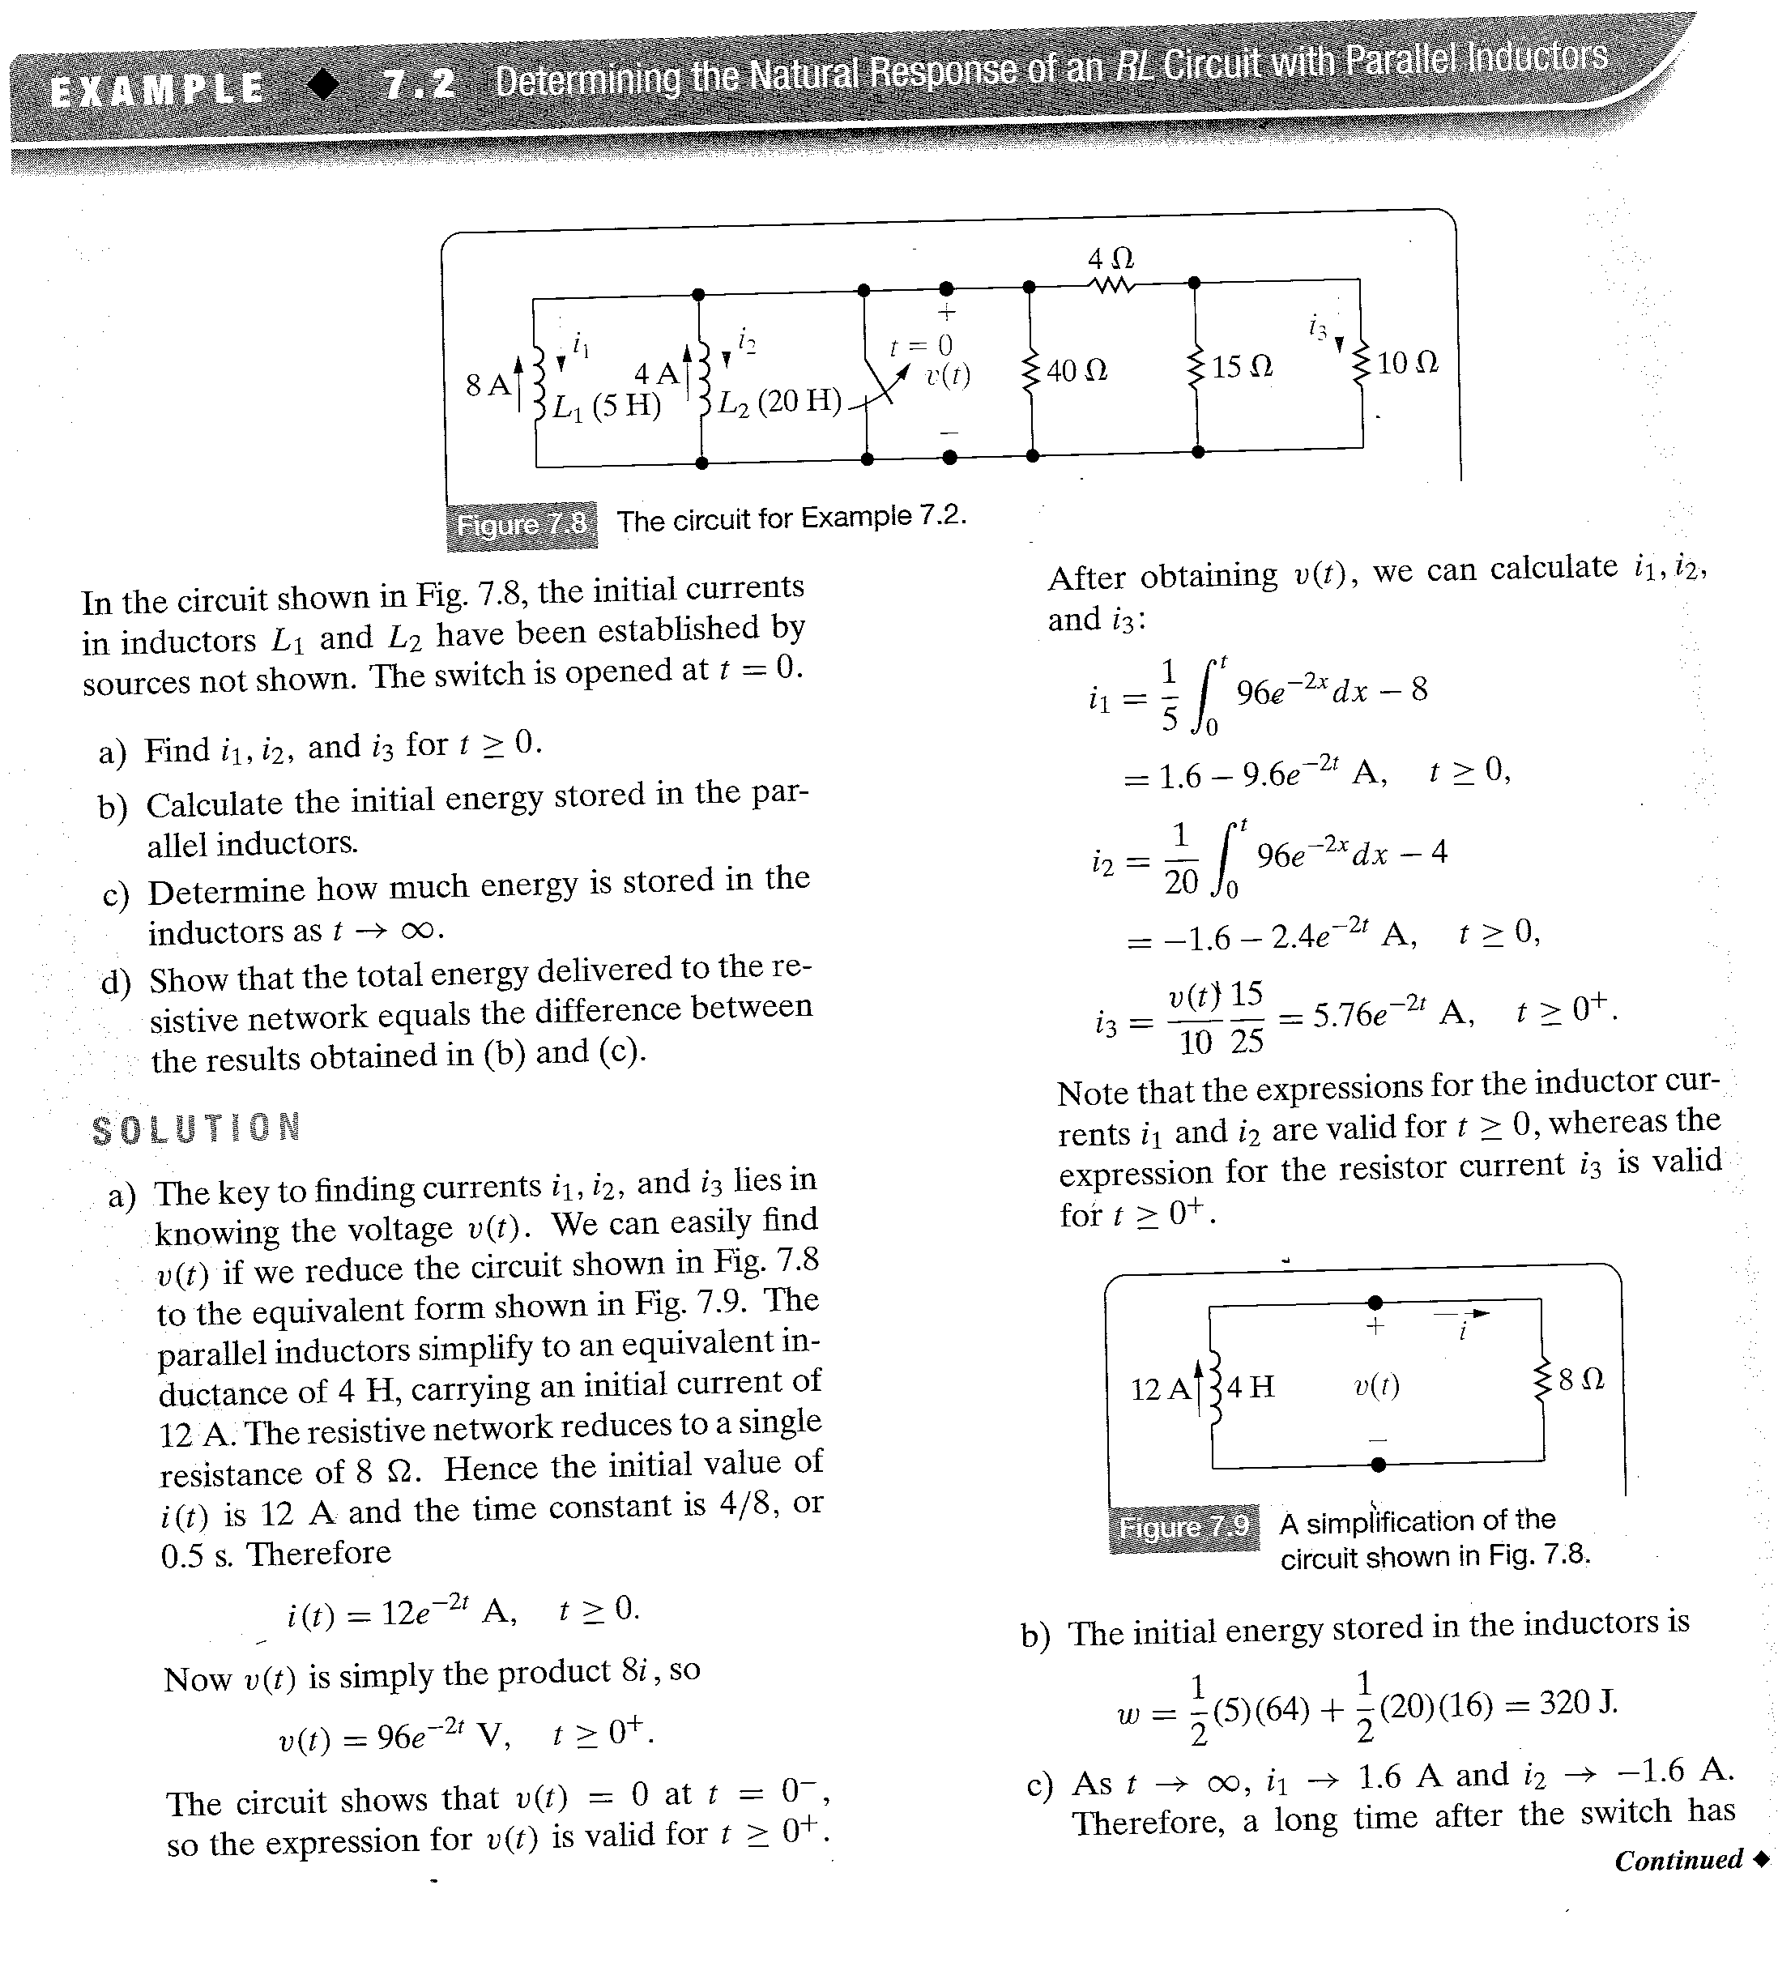

Slide 25
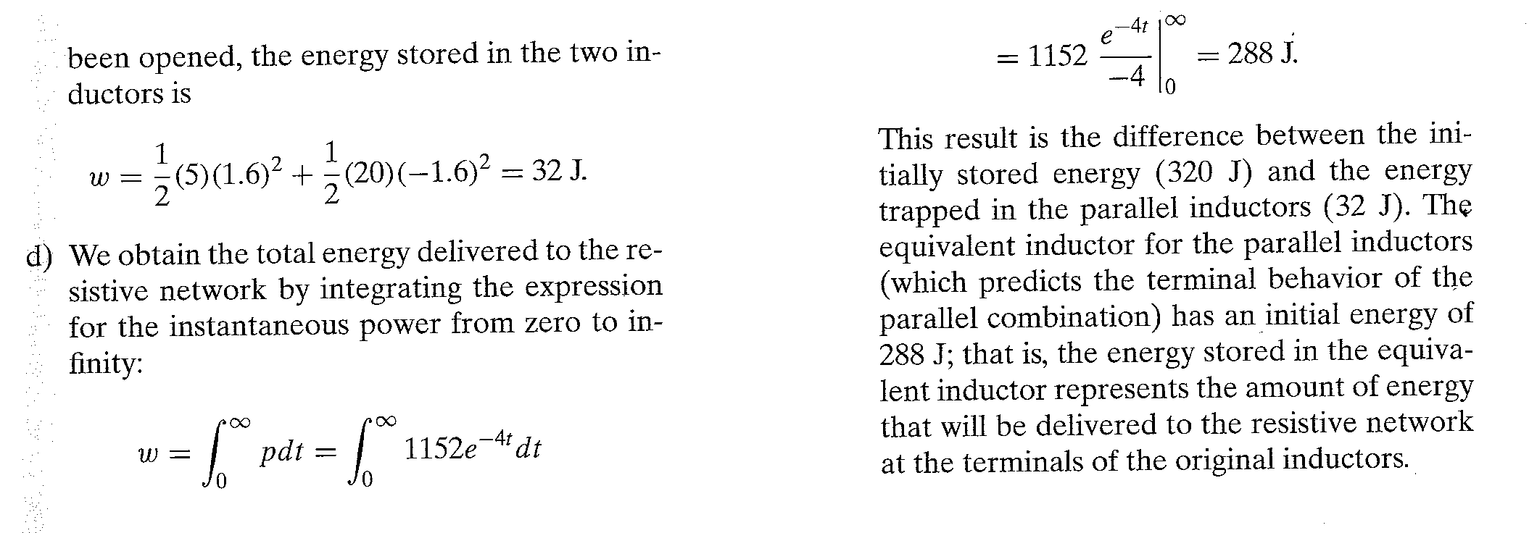
Homework Assessing Objective 1 - 7.1 ,7.2

Slide 26
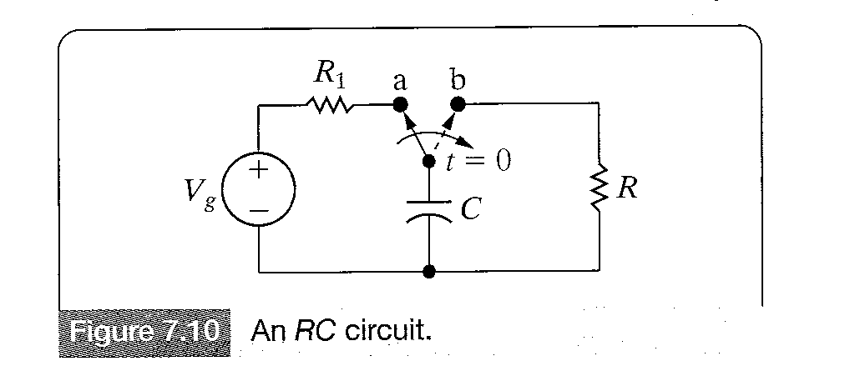
The Natural Response of an RC Circuit
The natural response of an RC circuit is analogous to that of an RL circuit.We use the circuit of figure 7.10 to develop the natural response of an RC circuit.
We assume that the switch
has been closed for a long
time so that steady state has
been reached.The capacitor
behaves as an open-circuit
when steady state has been
reached.There is no current
through the capacitor,the source
voltage appears across the
capacitor

Slide 27
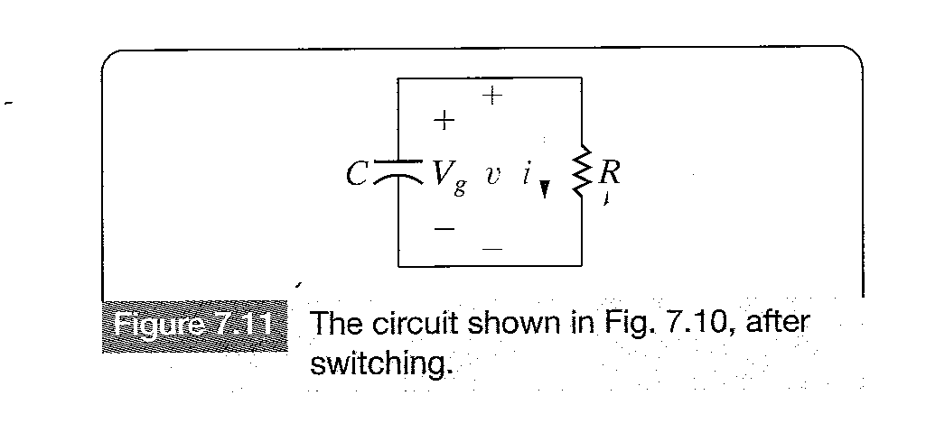
The Natural Response of an RC Circuit
As there can be no instantaneous change in the voltage at the terminals of a capacitor,the problem reduces to solving the circuit shown in Figure 7.11

Slide 28
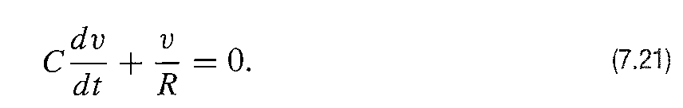
The Natural Response of an RC Circuit
Deriving the expression for the voltage
Using Kirchoff’s Current Law

Slide 29
The Natural Response of an RC Circuit
Comparing Eq.7.21 with Eq.7.1 shows that the same mathematical techniques can be used to obtain the solution for v(t).
=> =>
Taking t0=0
=> =>
=> (7.22)
The initial voltage across the capacitor equals Vg.
Where V0 denotes the initial voltage on the capacitor.

Slide 30
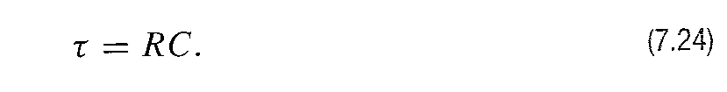
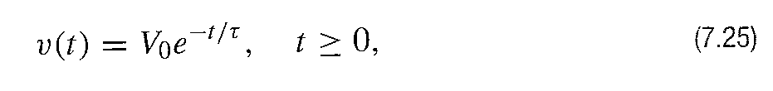
The Natural Response of an RC Circuit
The time constant for the RC circuit equals the product of the resistance and capacitance.
Substituting Equations 7.23 and 7.24 into Equation 7.22 yields
Which indicates that the natural response of an RC circuit is an exponential decay of the initial voltage.The rate of decay is determined by the time constant RC.

Slide 31
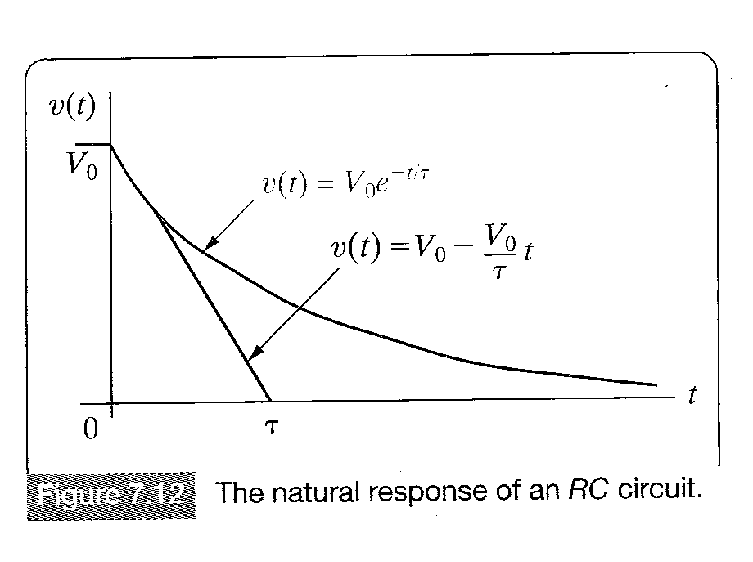
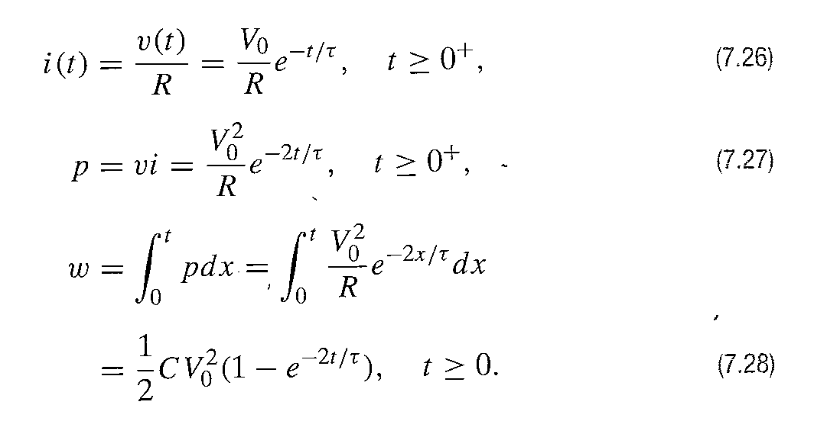
The Natural Response of an RC Circuit
Figure 7.12 shows the plot of Equation 7.25 and the graphic interpretation of the time constant.
Once v(t) is determined,the
expressions for i,p and w
can be determined.

Slide 32
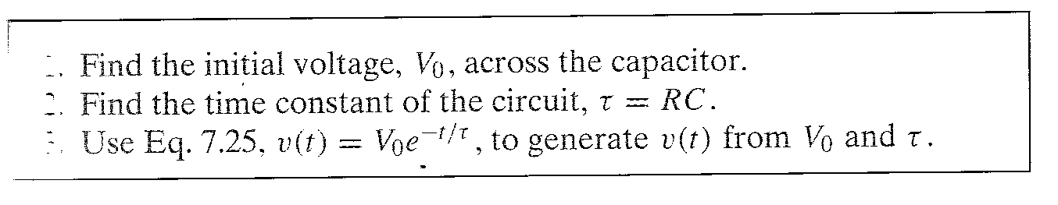
The Natural Response of an RC Circuit
Calculating the natural response of an RC circuit can be summarized as follows:

Slide 33
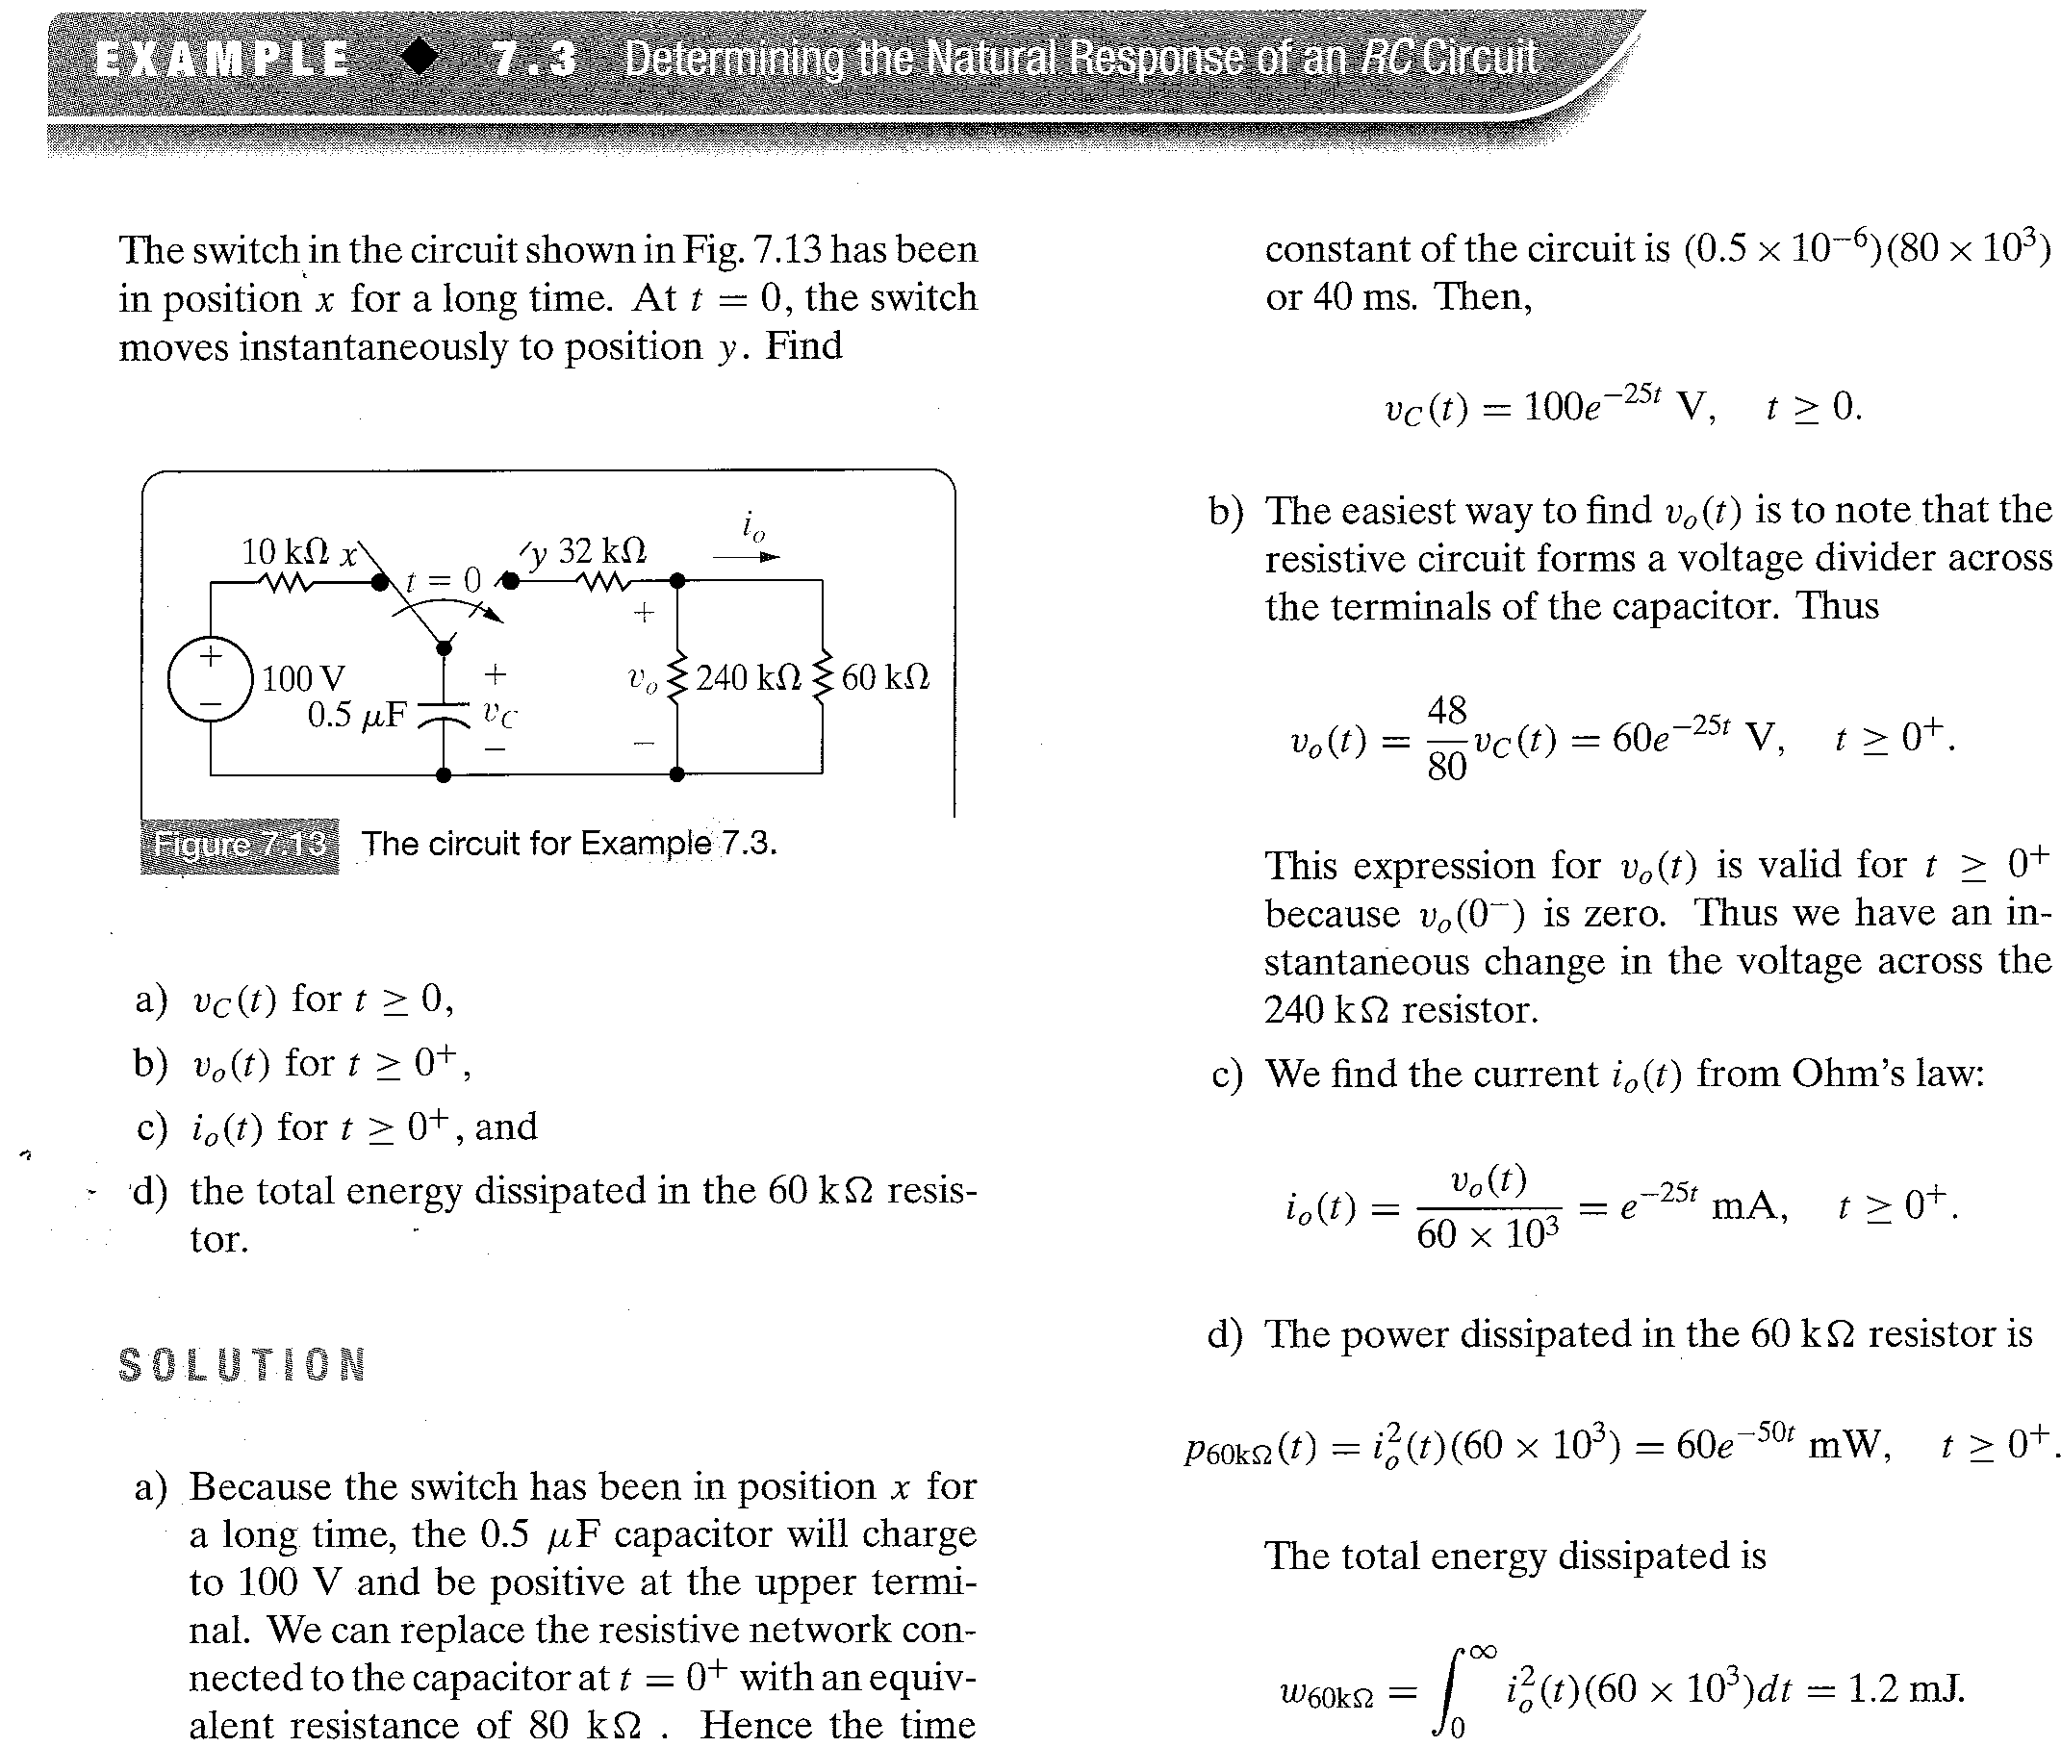

Slide 34
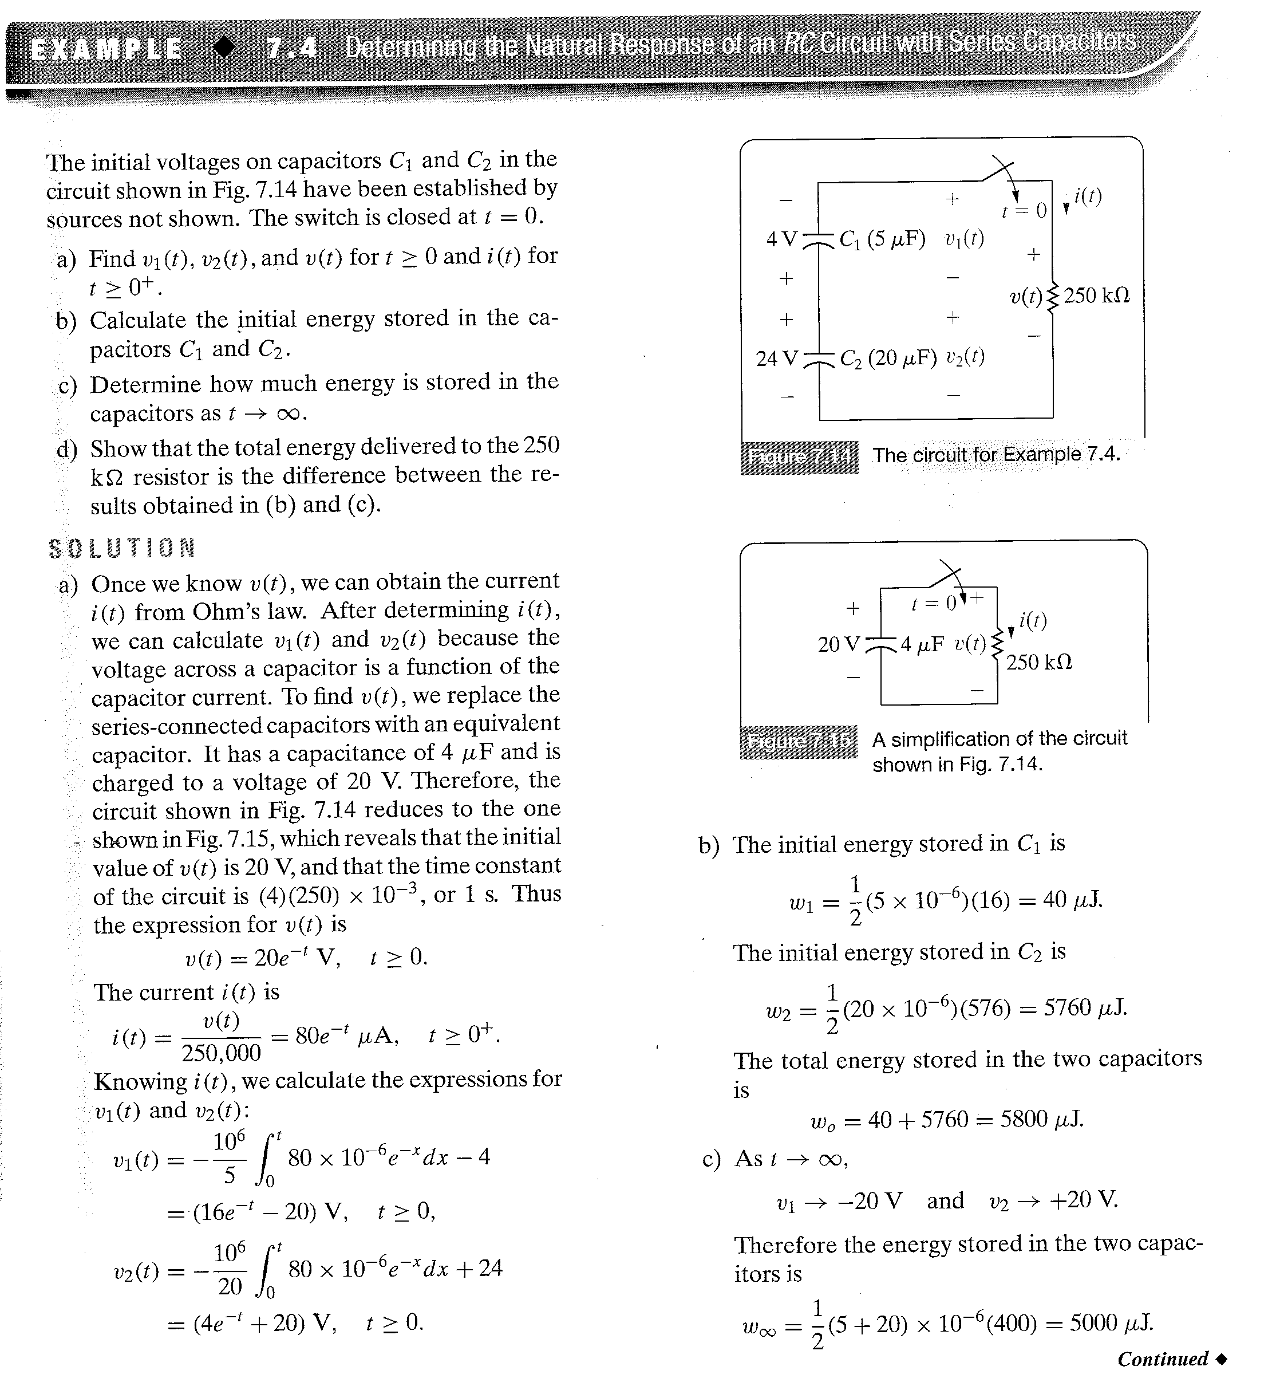

Slide 35
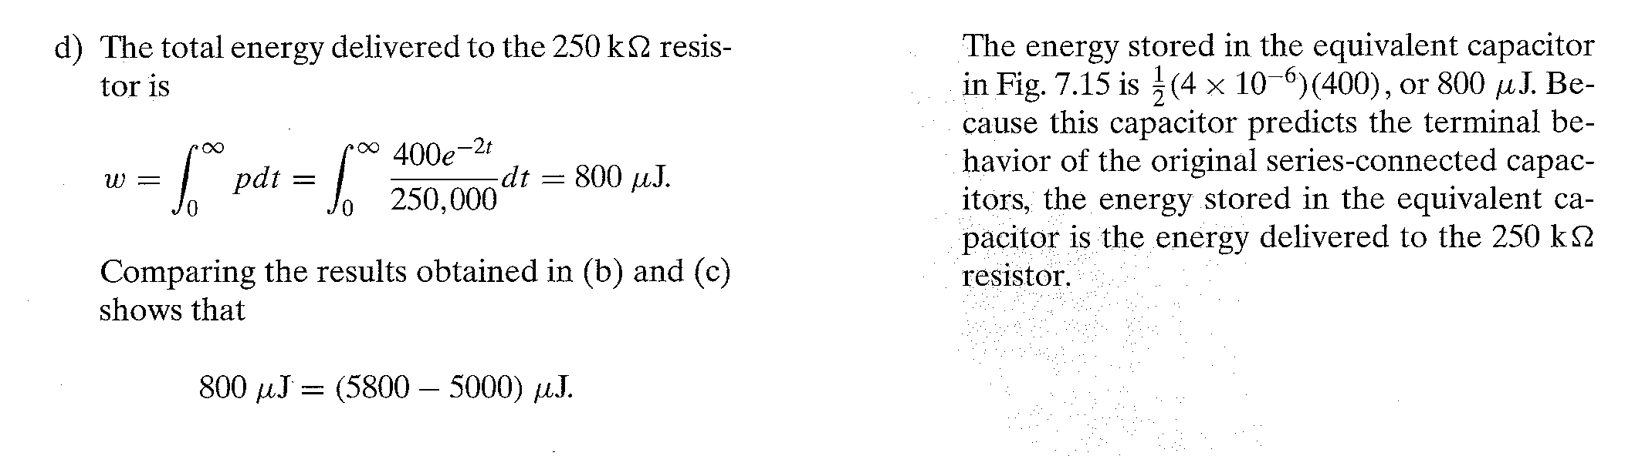
Homework Assessing Objective 1 – 7.3,7.4

Slide 36
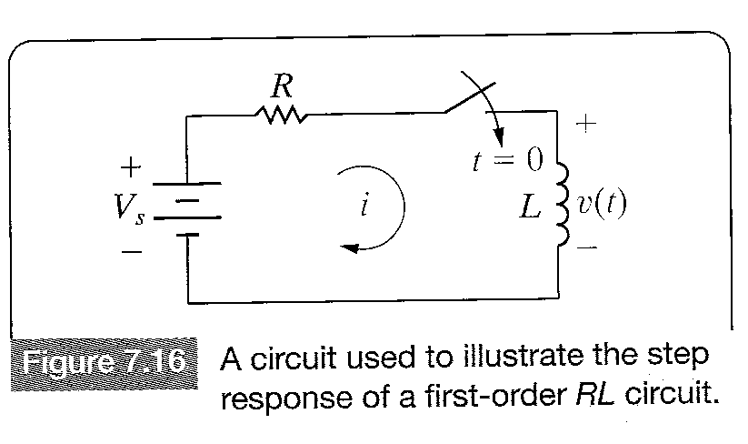
The Step Response of RL and RC Circuits
The response of a circuit to the sudden application of a constant voltage or current source is referred as the step response of the circuit.
The Step Response of an RL Circuit.
We add a switch to the first-order
Circuit shown in Figure 7.2 (a)
Energy is stored in the inductor
at the time the switch is closed
is given in terms of a nonzero
initial current i(0).

Slide 37
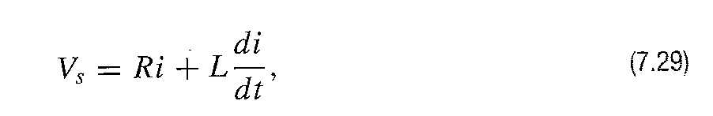
The Step Response of RL Circuit
The problem is to find an expression for the current in the circuit and for the voltage across the inductor after the switch has been closed.
Using Kirchoff’s voltage law:
Which can be solved for the current i by separating the variables i and t and then integrating.

Slide 38
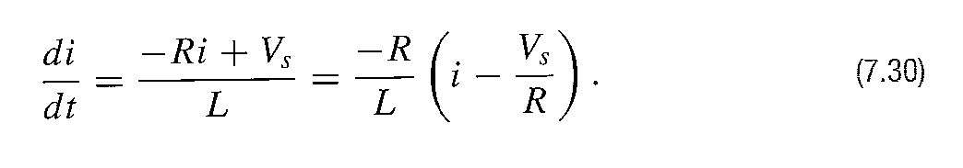
The Step Response of RL Circuit
The first step in this approach is to solve for the derivative .
Next we multiply both sides of Equation 7.30 by a differential time dt.This step reduces the left-hand side of the equation to a differential change in the current.

Slide 39
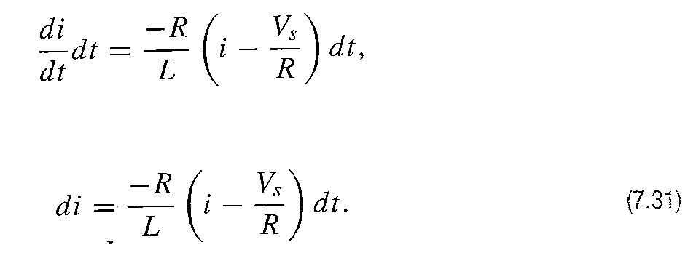
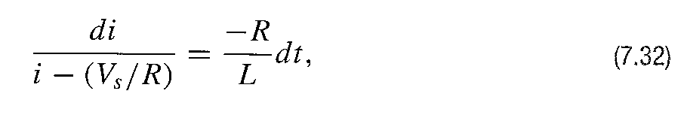
The Step Response of RL Circuit
Thus
Separating the variables in Equation (7.31),we get

Slide 40
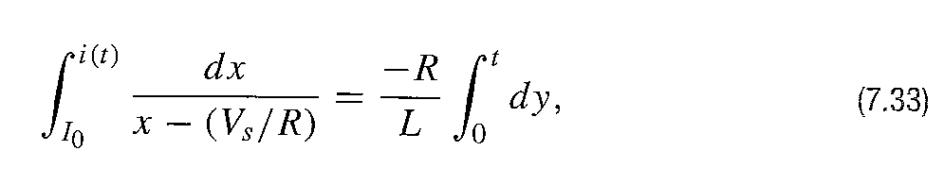
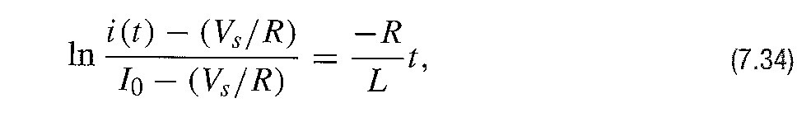
The Step Response of RL Circuit
Next we integrate both sides of Equation 7.32 using x and y as variables for the integration to obtain
Where is the current at t=0 and i(t) is the current at any t>0. Performing the integration called in Eq. 7.33 generates the expression

Slide 41
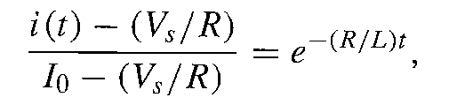
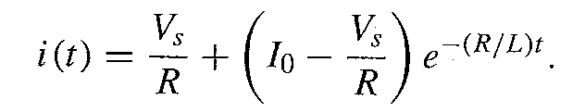
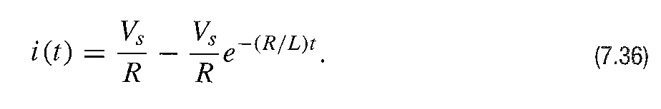
The Step Response of RL Circuit
From which
or 7.35
When the initial energy in the inductor is zero, is zero .Thus Eq. 7.35 reduces to

Slide 42
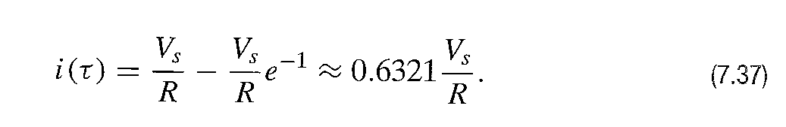
The Step Response of RL Circuit
Eq. 7.36 indicates that after the switch has been closed,the current increases exponentially from zero to a final value of Vs/R.The time constant of the circuit L/R determines the rate of increase.After one time constant the current will have reached approximately 63% of its final value,or

Slide 43
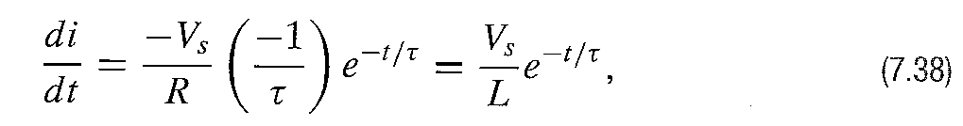
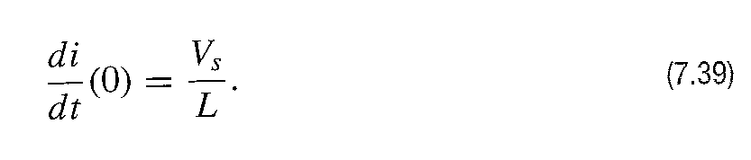
The Step Response of RL Circuit
If the current were to continue to increase at its initial rate,it would reach its final value at ,
that is because
The initial rate at which i(t) increases is

Slide 44
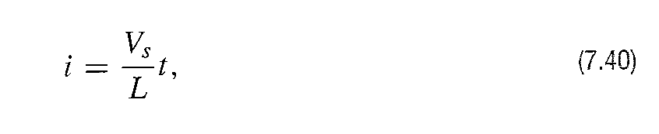

The Step Response of RL Circuit
If the current were to continue to increase at this rate,the expression for i would be
From which at

Slide 45

The Step Response of RL Circuit
Equations 7.36 and 7.40 are plotted in Figure 7.17.The values given by Equations 7.37 and 7.41 are also shown in this figure.

Slide 46

The Step Response of RL Circuit
The voltage across the inductor is ,so from
Equation 7.35 for .

Slide 47

The Step Response of RL Circuit
At the moment the switch is closed the inductor voltage jumps to and then decays exponentially to zero. The voltage drop across the resistor is and the voltage impressed across the inductor is the source voltage minus the voltage drop,that is, .
When the initial inductor current is zero,7.42 simplifies to

Slide 48
The Step Response of RL Circuit
If the initial current is zero,the voltage across the inductor jumps to .We also expect the inductor voltage to approach zero as t increases,because the current in the circuit is aproaching the constant value of .
Figure 7.18 shows the plot of Equation 7.43 and the relationship between the time constant and the initial rate at which the inductor voltage is decreasing.

Slide 49

The Step Response of RL Circuit

Slide 50


Slide 51

Homework Assessing Objective 2 – 7.5

Slide 52


The Step Response of RL Circuit
v(t) across the inductor in Figure 7.14 can also be described as follows:
Differentiating both sides with respect to time

Slide 53


The Step Response of RL Circuit
Multiplying each side ıf the Equation 7.45 by the inductance L,we get
Putting Equation 7.46 into standard form yields

Slide 54

The Step Response of RL Circuit
The solution of the above equation is identical to equation 7.42.
We now rewrite Equation 7.29 as
Observe that 7.47 and 7.48 have the same form,each equates the sum of the first derivative of the variable and a constant times the variable to value.

Slide 55

The Step Response of RC Circuit
The step response of a first-order RC circuit can be analyzed using the circuit shown below.

Slide 56


The Step Response of RC Circuit
Using Kirchoff’ Current Law
Division of Equation 7.49 by C gives

Slide 57

The Step Response of RC Circuit
Comparing Eq.7.50 with Eq. 7.48 shows that the form of the solution for vc is the same as that for the current in the inductive circuit,namely equation 7.35.Therefore,by simply substituting the appropriate variables and coefficients we can write the solution for vc directly.
The translation requires that Is replace vs,C replace L, 1/R replace R and V0 replace I0.
We get

Slide 58
The Step Response of RC Circuit
To find the capacitor current i,we simply take the derivative of the above equation and multiply by C.
(7.53)
Where V0 is the initial voltage of vc,the voltage across the capacitor.

Slide 59
The Step Response of RC Circuit
Let’s see whether these solutions for the RC circuit make sense in terms of known circuit behaviour.From Equation 7.51,note that the initial voltage across the capacitor is V0,the final voltage across the capacitor is IsR,and the time constant of the circuit is RC.We also note that the solution for vc is valid for t>=0.These observations are consistent with the behaviour of a capacitor in parallel with a resistor driven by a current source.

Slide 60
The Step Response of RC Circuit
According to Equation 7.53 the current in the capacitor at is .
This prediction makes sense,because the capacitor voltage cannot change instantaneously,and therefore the initial current in the resistor is .
The capacitor branch current changes instantaneously from zero at to
at .The capacitor current is zero at and note that the final value of v is

Slide 61

Homework Assessing Objective 2 -7.6

Slide 62

A General Solution For Step and Natural Responses

Slide 63

A General Solution For Step and Natural Responses
To generalize the solution of these four possible circuits,we let x(t) represent the unknown quantity,giving x(t) four possible values.
It can represent the current or voltage at the terminals fo an inductor or the current or voltage at the terminals of a capacitor.
The differential equation describing any of the four circuits in Figure 7.24 takes the form.

Slide 64
A General Solution For Step and Natural Responses
Where the value of the constant K can be zero.
Because the sources in the circuit are constant voltages and/or currents,the final value of x will be constant;that is the final value must satisfy Equation 7.54,and when x reaches its final value,the derivative must be zero. Hence
Wher xf represents the final value of the variable.

Slide 65


A General Solution For Step and Natural Responses
Equation 7.54 is solved for the first derivative by separating the variables.
Where Equation 7.55 has been used to subtitute xf for .
Multiplying both sides of Equation (7.56) by dt and dividing by x-xf,we obtain

Slide 66


A General Solution For Step and Natural Responses
Integrating both sides,we obtain
Carrying out the integration called for in Equation 7.58 gives
GENERAL SOLUTION FOR NATURAL AND STEP RESPONSES OF RL AND RC CIRCUITS

Slide 67
A General Solution For Step and Natural Responses
The importance of Equation (7.59) becomes apparent if we write it out in words:
The unknown variable as a function of time = The final value of the variable
+[The initial value of the variable-the final value of the variable}*
7.60
In many cases time of switching that t0=0.

Slide 68
A General Solution For Step and Natural Responses
When computing the step and natural responses of circuits,it may help to follow these steps:
1-Identify the variable of interest for the circuit.For RC circuits,it is most convenient to choose the capacitance voltage,for RL circuits,it is best to choose the inductive current.
2-Determine the initial value of the variable,which is its value at t0.Note that if you choose capacitive voltage or inductive current as your variable of interest,it is not necessary to distinguish and .This is because they are both continous variables.If you choose another variable,you need to remember that its initial value is defined at

Slide 69
A General Solution For Step and Natural Responses
3-Calculate the final value of the variable,which is its value as .
4-Calculate the time constant for the circuit.
With these quantities,equation 7.60 can be used to produce an equation describing the variable of interest as a function of time.Othe circuit variables can be found using analysis techniques introduced in Chapter 3 or 4.

Slide 70

A General Solution For Step and Natural Responses

Slide 71


Slide 72


Slide 73


